Slide 1
Module 2: Enhanced ER Modeling
COMP 2714 – Relational Database Systems
Learning Outcome: LO2 – Apply techniques of database design including enhanced entity–relationship modeling.

Slide 2

Blueprint for a database?
Like building cars or building houses, building a database needs a blueprint
We need to create a model first and then implement it
How do we create a model for a database?

Slide 3
What is a data model?
Remember that a vital part of the database designer’s job is to determine what data to enter into the database and how to organize that data
A data model defines and describes the structures for storing data , the rules for ensuring data integrity and the methodologies for data access and manipulation
A data model is both narrative & graphical

Slide 4
Data Model Building Blocks
Entities
CUSTOMER
- Last name
- first name
- phone number
- ...
Attributes
Relationship
AGENT
Constraint:
Agent’s Salary must be between 6,000 - 110,000

Slide 5
Business Rules
To discover business rules ask these questions:
What data exists?
How is it used?
You should write down the business rules as you discover them and try to verify their validity by asking multiple people in an organization to share their view of data and what they are using it for.
Business rules establish entities and the relationships between them as well as data constraints.

Slide 6
Examples of Business Rules
A pilot cannot be on duty for more than 10 hours during a 24-hour period.
A professor may teach up to four classes during a semester.

Slide 7
Entity Relationship Diagram (ERD)
Entity
A person, place, thing, concept, or event for which data can be stored.
written in CAPITAL LETTERS
Relationship
An association between entities.
Ask two questions to identify the type of each relationship:
How many CUSTOMERs does an AGENT serve?
How many AGENTs serve a single CUSTOMER?
AGENT
Serves
CUSTOMER

Slide 8
Relationship Types
One to Many → 1:M or 1..*
A painter paints many paintings
Each painting is painted by only one painter
One to One → 1:1 or 1..1
Each store is managed by a single employee
Each store manager manages only a single store
Many to Many→ M:N or *..*
An employee may learn many job skills
Each job skill may be learned by many employees
paints
PAINTER
PAINTING
manages
EMPLOYEE
STORE
learns
EMPLOYEE
SKILL

Slide 9
ER Modeling
A deeper dive into building a blueprint for a relational DB

Slide 10
Characteristics of Attributes

Slide 11
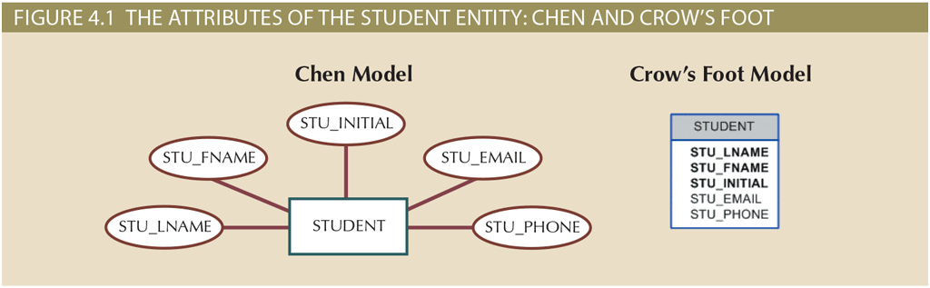
Required or Optional?
Required or Optional
Bold-faced in CF notation

Slide 12
PKs
Every entity must have an identifier
Identifiers (PKs) are underlined in ERDs
Pk is ideally one attribute
But sometimes a composite

Slide 13
Simple or Composite?
Attributes are either simple or composite
Always be in the lookout for composite attributes
→ Business rules talk often in terms of composite attributes
→ Designer should recognize them + determine the correct way to decompose
Can be divided to yield additional attributes (e.g. ADDRESS)

Slide 14
Single-Valued or Multivalued?
Attributes can be single-valued or multivalued
Can have only a single value, e.g.
SIN for person
Serial# of manufactured parts
Single-valued is not necessarily simple
SE-08-02-189935
Can have many values, e.g.
Person → several degrees
Household → several phones
Car’s color -> roof / trim / body
Region
Plant
Shift
Part #

Slide 15
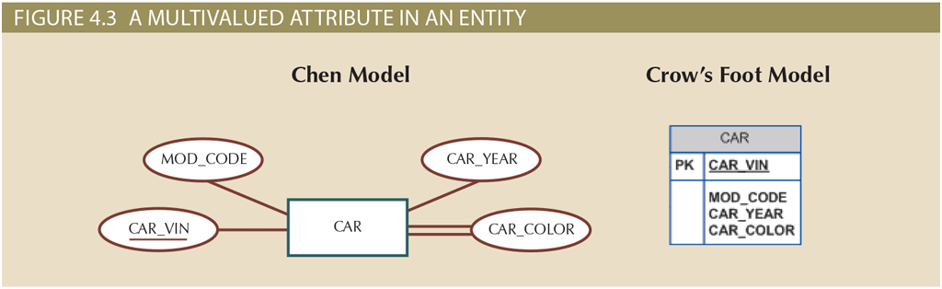
Modeling Multivalued Attributes
in ER modeling, attributes can be multi-valued
In the relational model, multi-valued attributes are not allowed
They must be transformed before implementation
(Details → Module 3: Mapping ER → Relational Schema)
For now: just recognize them in ERDs and know they will require special handling
Multivalued Attribute

Slide 16
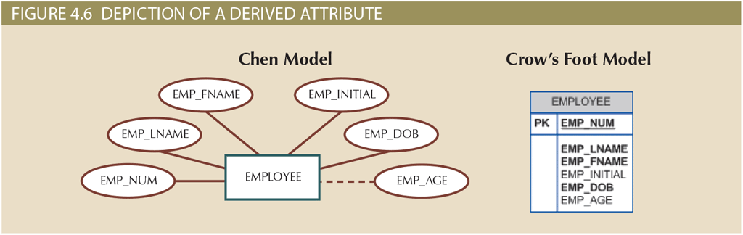
Derived (Computed) Attributes
The value of the attribute is derived from other attributes
e.g. Age, Total Cost of Orders, Avg Speed

Slide 17
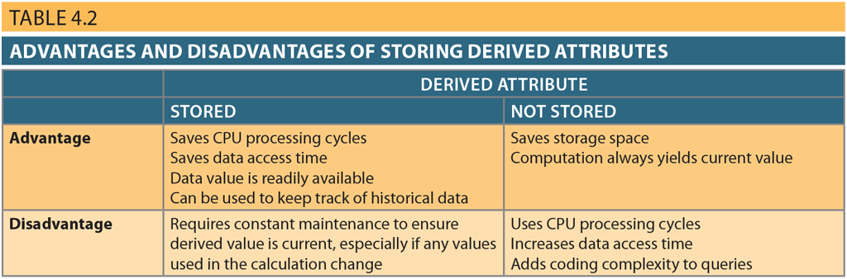
Implementing Derived Attributes
Designer should be aware of advantages & disadvantages of storing derived attributes

Slide 18
Attributes Dive In Checklist
Specify required attributes
Specify identifiers (PKs)
Are there any composite attributes?
Do we need to decompose?
Specify multivalued attributes
What is the best way to implement them?
Should we define any derived attributes?

Slide 19
2. Characteristics of Relationships

Slide 20
Relationships
Participants: entities in relationships
Name of the relationship → Active or passive verb
Always bidirectional → you should know both sides to be able to detect the type of the relationship

Slide 21
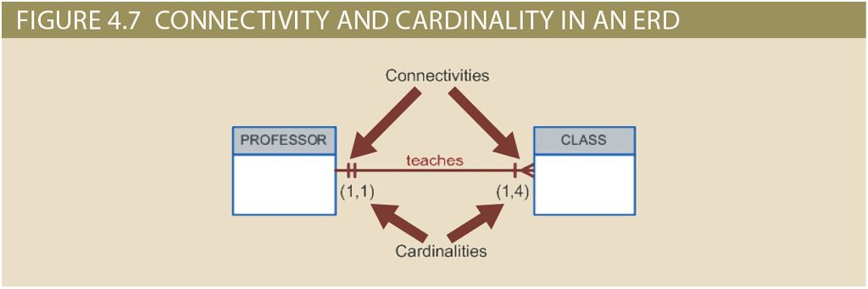
Connectivity & Cardinality
Connectivity: Relationship Classification (1:1, 1:M, M:N)
Cardinality: Expresses min & max number of instances in relationship
Cardinality cannot be implemented in the DBMS directly
Application software or triggers can handle cardinality

Slide 22
Existence Dependence
Some entities, we should keep in the database, only if they are related to another entity in our system
Example: “EMPLOYEE Claims DEPENDENT”
If the employee is removed from the database, we clearly should remove his dependents from the database as well.

Slide 23
3. Relationship Strength

Slide 24
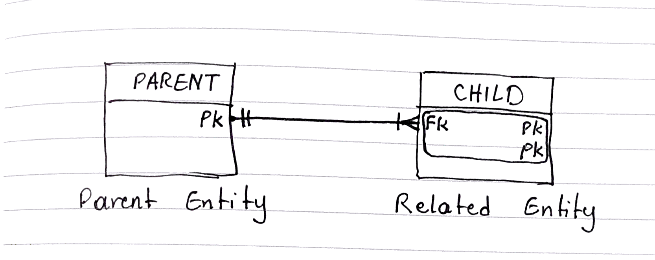
Strong Relationships
Sometimes the primary key of the child entity includes the primary key of the parent. This kind of parent-child relationships are called strong relationships.

Slide 25
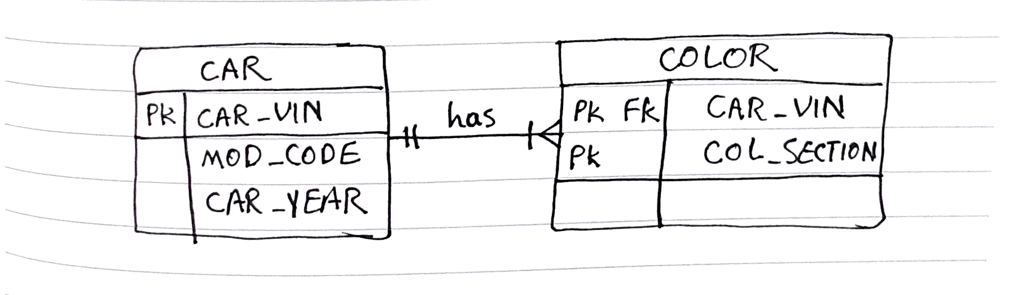
Modeling Strong Relationships
Strong relationships (also called identifying relationships) are specified with solid lines in Crow’s Foot ERDs.

Slide 26
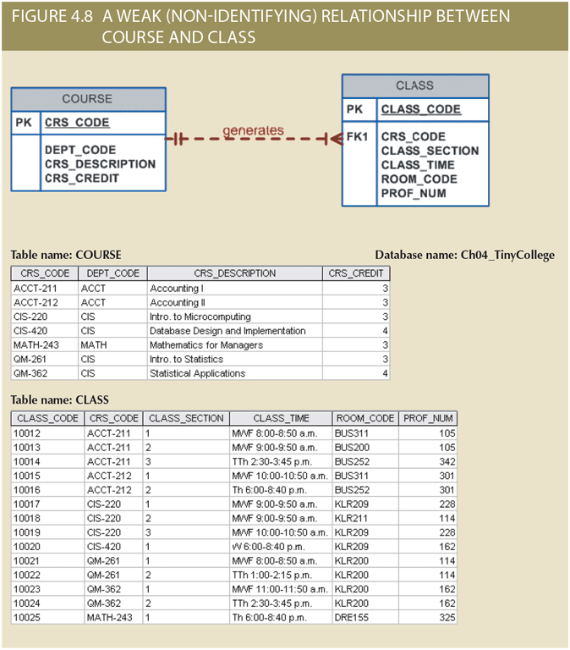
Weak Relationships
The PK of the child does not inherit a component from the parent PK
The parent’s PK is only a foreign key in the child table (and not part of child’s primary key)
Weak relationships are specified by dashed lines in Crow’s Foot ERDs.

Slide 27
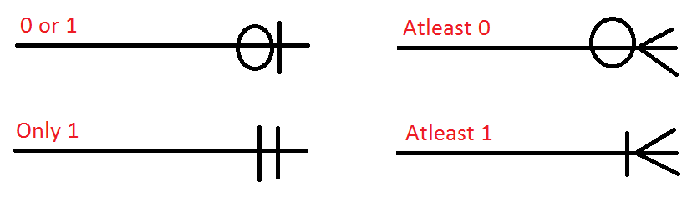
Relationship Participation
An entity’s participation in a relationship might be optional or mandatory
Relationship Participation ≠ Relationship Strength
Possible to have strong but optional relationships
e.g. Employee claims Dependent
Possible to have weak but mandatory relationships

Slide 28
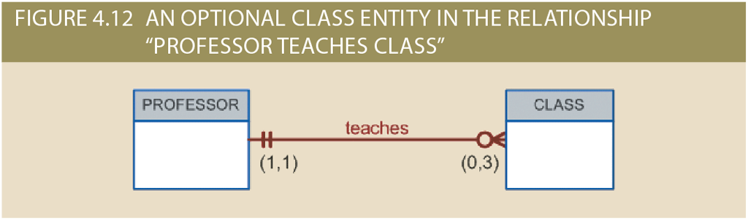
Relationship Participation
Class is optional to professor
professors who conduct research without teaching classes
Professor is mandatory to class

Slide 29
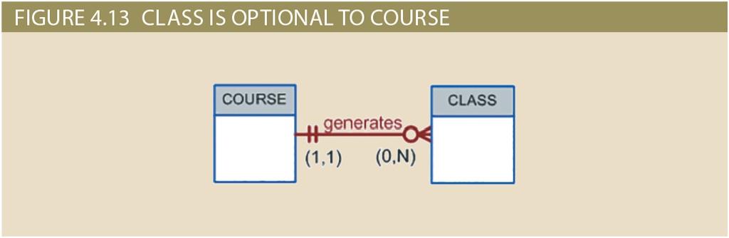
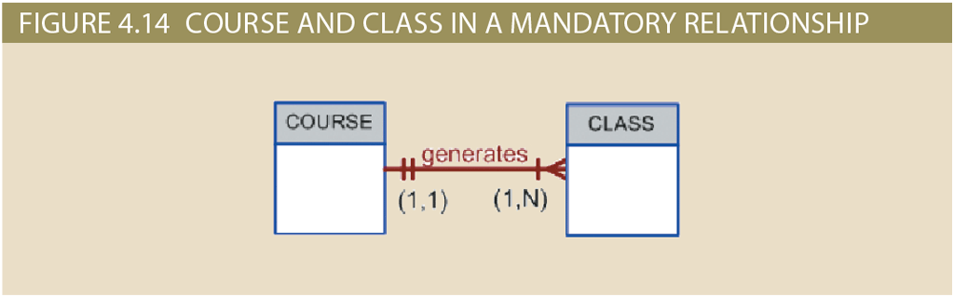
Relationship Participation
COURSE is mandatory in the relationship. But the participation of the CLASS entity might be optional or mandatory.
Optionality Reflects Practice

Slide 30
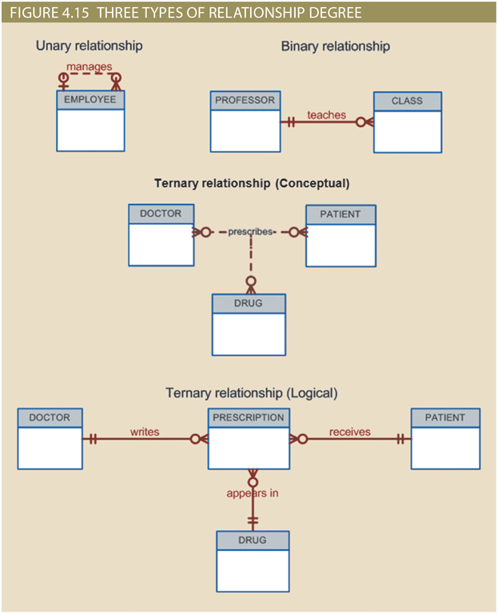
Relationship Degree
Unary
Binary
Ternary

Slide 31
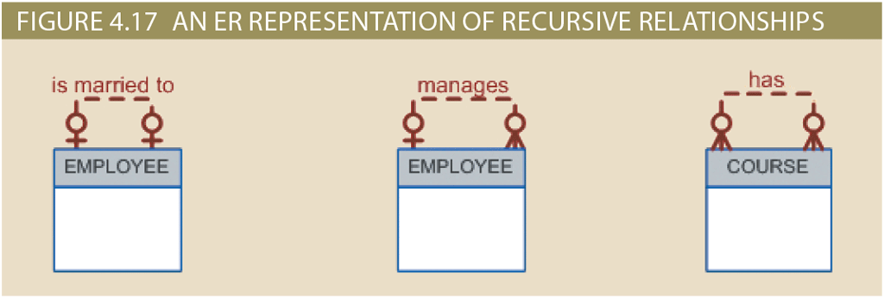
Recursive Relationships
Naturally occurs in unary relationships
A recursive relationship might be 1:1, 1:M or M:N

Slide 32
3. Characteristics of Entities

Slide 33
Weak Entities
!DO NOT CONFUSE WITH WEAK RELATIONSHIPS!
Two Conditions - Both are required for an entity to be weak:
Existence Dependent → Entity cannot exist without the parent entity
Has a Primary Key that is partially or totally derived from the parent key (Strong relationship with the parent)
In other words, an entity can be existence-dependent but not weak

Slide 34
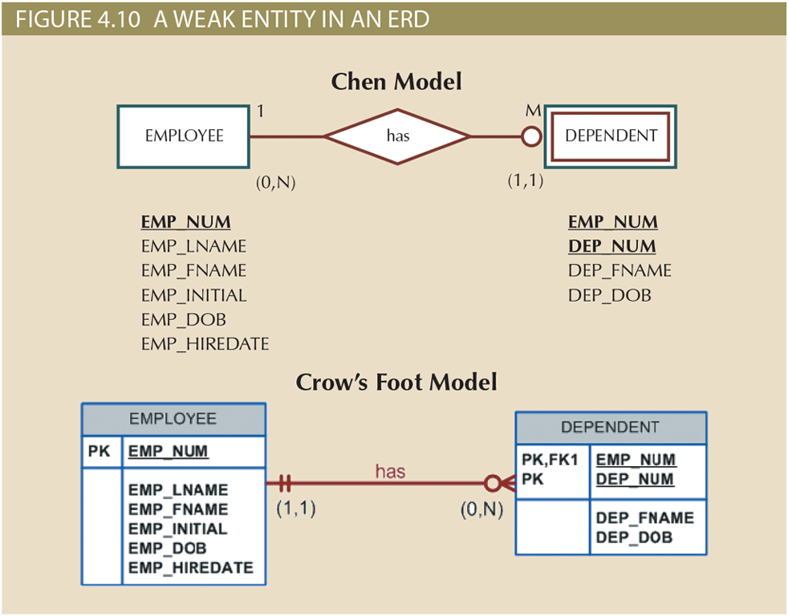
Modeling Weak Entities
Double walled → Weak Entity
In Crow’s Foot, weak entities are recognizable by noticing the strong relationship they have with parent entity and the fact that the child’s PK includes parent’s PK

Slide 35
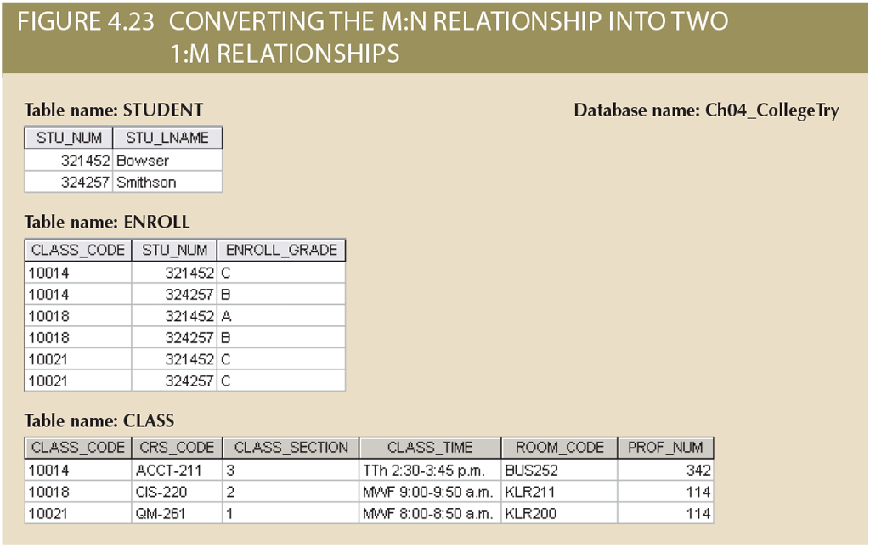
Associative (Composite) Entities
ENROLL is existence-dependent on the two other entities
No nulls in ENROL’s PK
“Optionality reflects practice”

Slide 36
EERD
EERD builds on ER and adds support for entity supertypes, subtypes and clusters.
Sometimes referred to as Enhanced ER Model.
EERM adds more semantic constructs to the original ER Model.

Slide 37
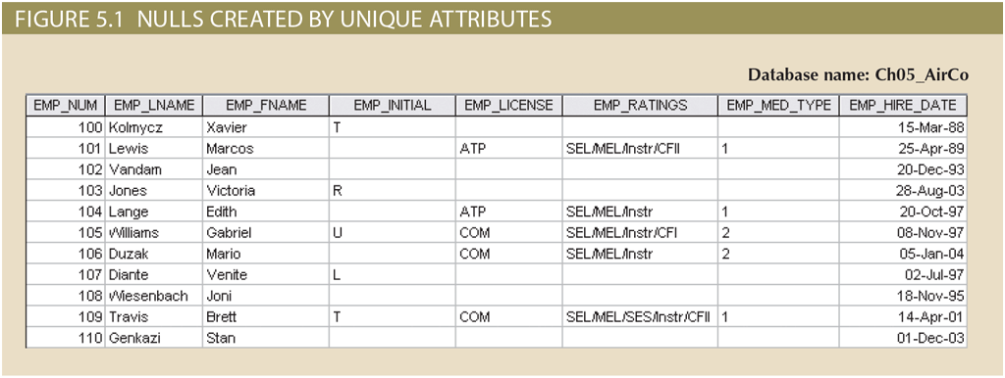
Supertypes & Subtypes
The following is example data for all employees hired by an aviation business: pilots, mechanics, accountants, DB designers, etc.

Slide 38
Supertypes & Subtypes
The following is example data for all employees hired an aviation business: pilots, mechanics, accountants, DB designers, etc.
But these attributes only apply to pilots not accountant or mechanics.

Slide 39
Supertypes & Subtypes
When some employees have characteristics that are not shared by other employees, we see unnecessary nulls in the table.

Slide 40
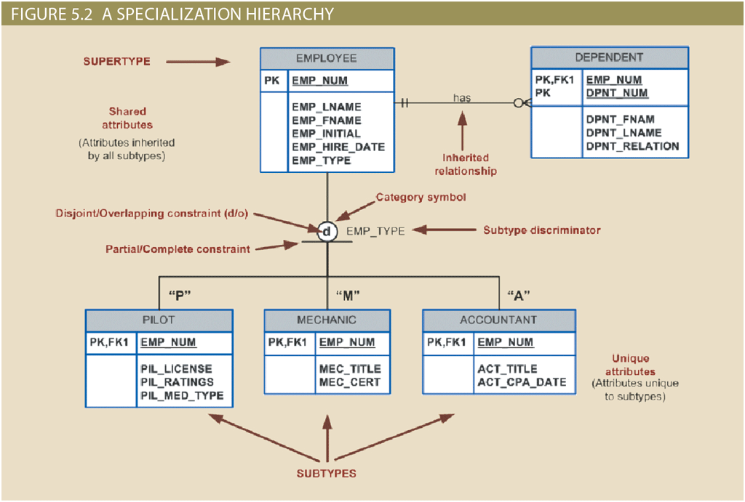

Slide 41
Supertype: a generic entity type that is related to one or more subtypes

Slide 42
Supertype: a generic entity type that is related to one or more subtypes
supertype contains common characteristics

Slide 43
Supertype: a generic entity type that is related to one or more subtypes
supertype contains common characteristics
subtypes each contain their own unique characteristics

Slide 44
Use subtypes/supertypes when there are different kinds/types of the entity in the user environment AND each type has one or more attributes that is unique to its kind.

Slide 45
Specialization Hierarchy
A specialization hierarchy enable the data model to capture additional semantic content:
attribute inheritance
a special supertype attribute known as subtype discriminator
disjoint or overlapping constraints
complete or partial constraints

Slide 46
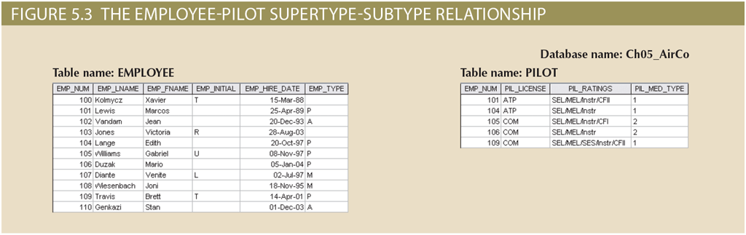
Inheritance
the entity subtype inherits the attributes and relationships of the supertype
all subtypes inherit their primary key attribute from their supertype
Subtype and supertype have a 1:1 relationship in implementation level

Slide 47
Supertype: a generic entity type that is related to one or more subtypes
Supertype contains common characteristics
Subtypes each contain their own unique characteristics

Slide 48
Supertype: a generic entity type that is related to one or more subtypes
Supertype contains common characteristics
Subtypes each contain their own unique characteristics
Entity subtypes inherit all relationships in which the supertype participates

Slide 49
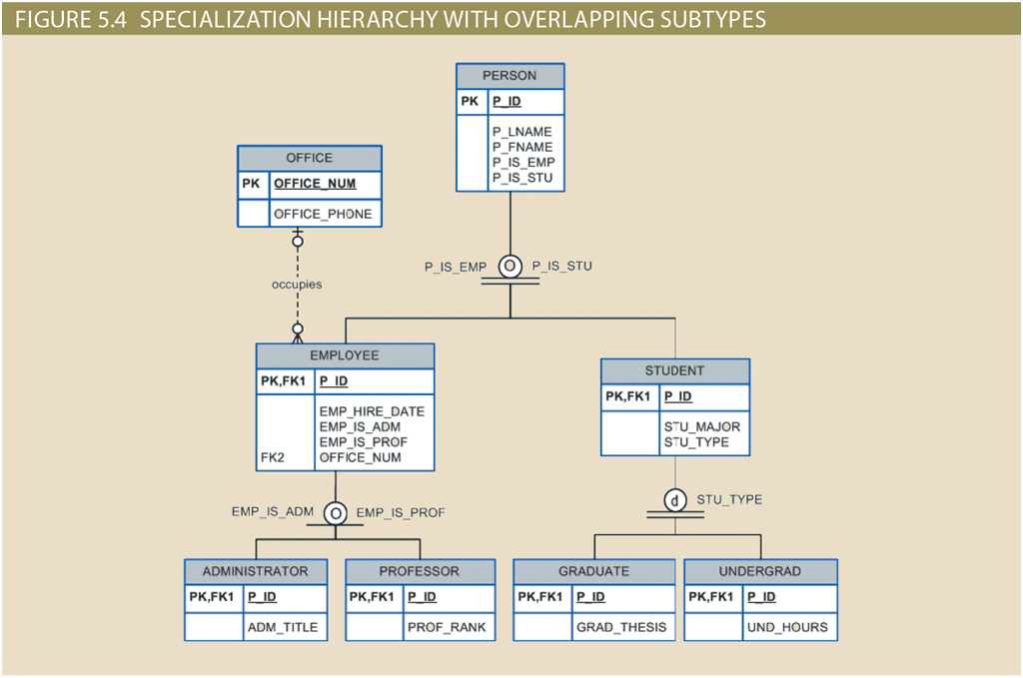

Slide 50
Subtypes can have relationships of their own.

Slide 51
Subtype Discriminator

Slide 52
Subtype Discriminator
A property of the supertype that indicates to which subtype the supertype is related to.

Slide 53
Subtype Discriminator
A property of the supertype that indicates to which subtype the supertype is related to.
It is common practice to show the subtype discriminator and its value for each subtype on the ERD.

Slide 54
Subtype Discriminator
A property of the supertype that indicates to which subtype the supertype is related to.
It is common practice to show the subtype discriminator and its value for each subtype on the ERD.
by default — but not necessarily — the subtype discriminator is based on an equality comparison.

Slide 55
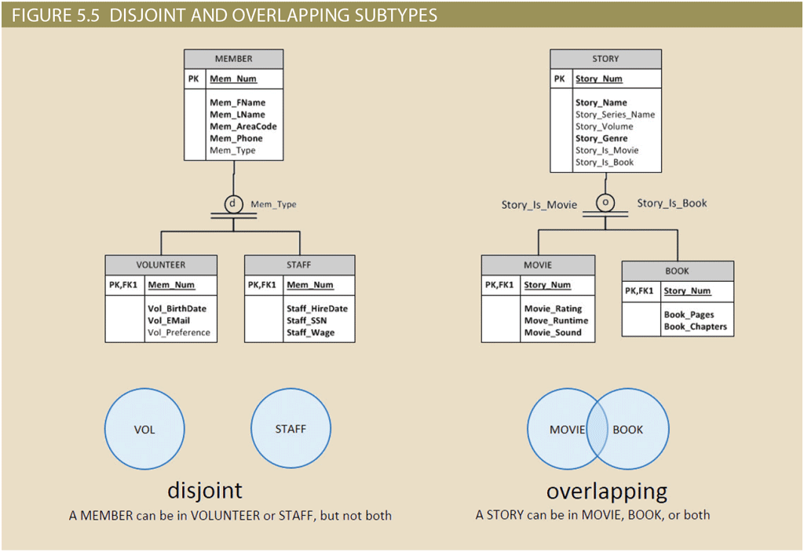
Disjoint or Overlapping
The business rules indicate whether an entity can only be part of one subtype or more.

Slide 56
Disjoint or Overlapping
The business rules indicate whether an entity can only be part of one subtype or more.
Disjoint or non-overlapping subtypes are indicated with letter d inside the category shape.

Slide 57
Disjoint or Overlapping
The business rules indicate whether an entity can only be part of one subtype or more.
Disjoint or non-overlapping subtypes are indicated with letter d inside the category shape.
Overlapping subtypes are indicated with the letter o inside the category shape

Slide 58
Disjoint or Overlapping
The business rules indicate whether an entity can only be part of one subtype or more.
Disjoint or non-overlapping subtypes are indicated with letter d inside the category shape.
Overlapping subtypes are indicated with the letter o inside the category shape
Implementing overlapping subtypes requires one discriminator attribute for each subtype.

Slide 59
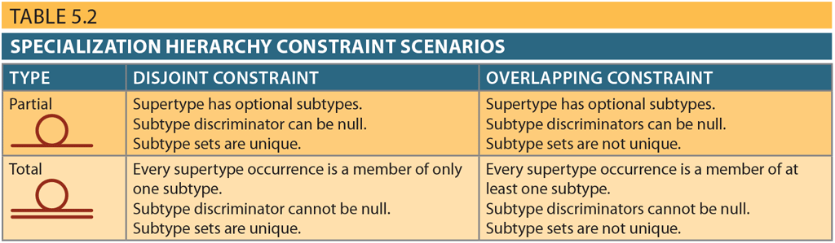
Completeness Constraint
whether each supertype occurrence is a member of at least one subtype
Partial Completeness: not every supertype occurrence is a member of a subtype
Total Completeness: every supertype occurrence must be a member of at least one subtype.
alternative notations exists for showing partial or total completeness

Slide 60
Example
Clerk is an identifiable kind but doesn’t have any attributes unique to it. So it should not be implemented as a subtype. Therefore the specialization hierarchy is modeled as partial.

Slide 61
The Extended Entity Relationship Model (EERD)
Subtypes & Supertypes
Entity Clustering

Slide 62
Entity Clustering
ERDs in the real world usually include hundreds of entities and relationships which make the ERD crowded and not very useful as a communication tool.
To simplifying the diagram, we can cluster multiple entities and the relationships between them when the entities logically belong together.

Slide 63
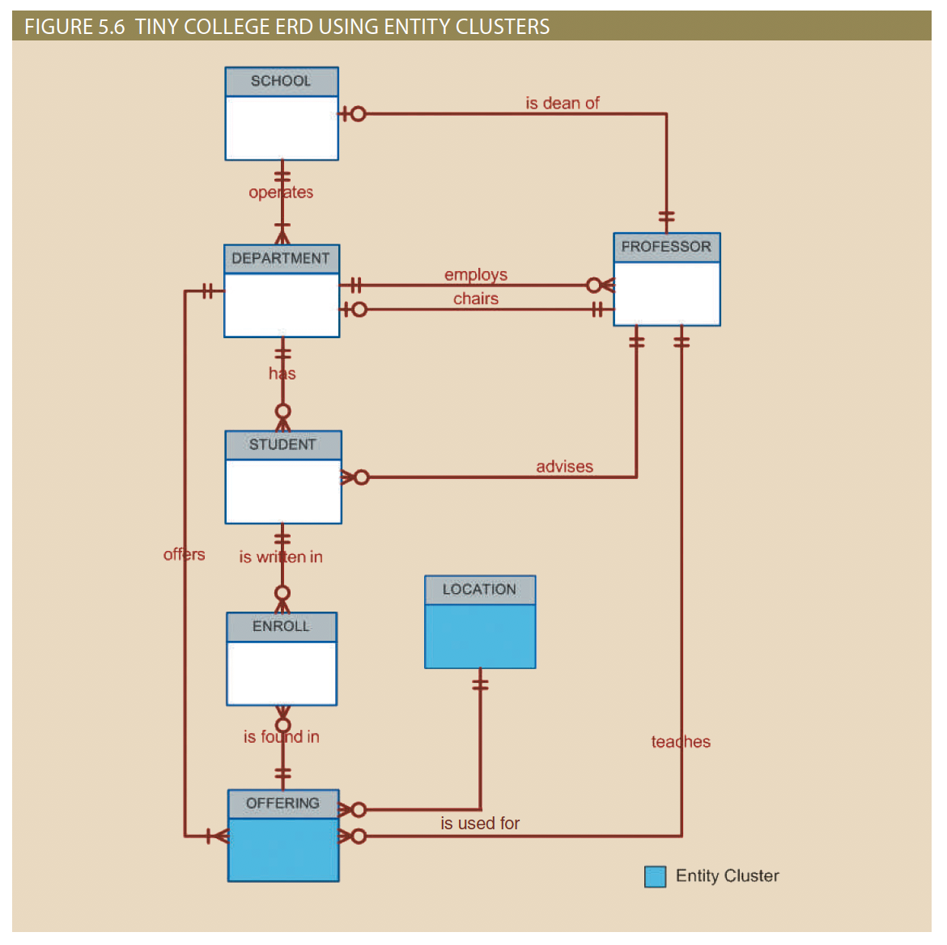
OFFERING is a cluster which includes SEMESTER, COURSE and CLASS entities.
A LOCATION specifies both BUILDING and ROOM within the building.

Slide 64
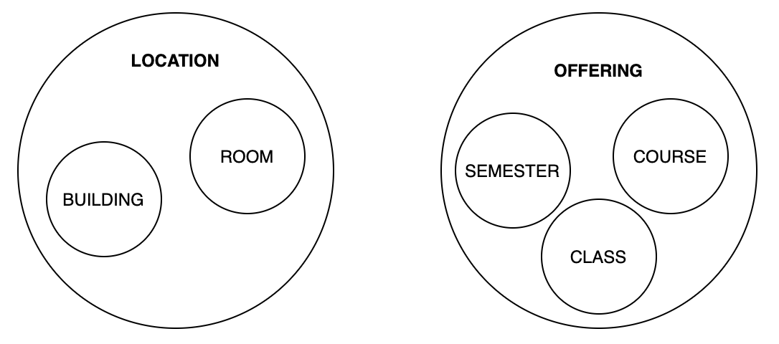
OFFERING is a cluster which includes SEMESTER, COURSE and CLASS entities.
A LOCATION specifies both BUILDING and ROOM within the building.
In a sense we are building a generalization hierarchy. We are grouping these entities together which collectively represent a higher, more general concept.

Slide 65
Takeaways & Next Steps
By the end of this module, you should be able to:
Recognize entities, attributes, and relationships in business rules
Distinguish attribute types (required vs optional, composite, multivalued, derived)
Understand relationship properties (connectivity, cardinality, strength, participation, recursive)
Identify special entities (weak entities, associative entities)
Apply enhanced ER concepts (supertypes, subtypes, specialization, disjoint/overlapping, completeness, clustering)
Next Steps → Module 3
Learn how to map ER/EER diagrams into relational schemas
See how keys, foreign keys, and constraints enforce these designs

